Slide 1
Smart India Hackathon
Team : Cantor
Members :
Atul Kumar(Team Leader)(16MT10009)
Akash Meshram(16MT10005)
Pritam Priyadarshi(16ME33013)
Rishabh Singhal(16NA10019)
Saloni Meshram(16MT10020)
VIshwajeet Kumar(16MA20050)

Slide 2
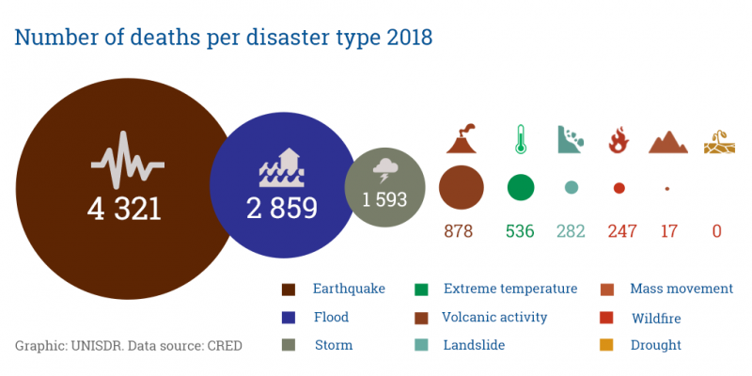

Problem : SS42
Classical medical facilities fail to cater in case of a significant spike in casualties

Slide 3




Our Solution :
A scalable software solution for medical attention during disasters
Feature to send SOS to contacts, Social Media, Public Services etc
An AI enabled chatbot for emergency guide
SOS
CHATBOT
Option to locate nearby Hospitals, Police Stations etc
Dashboard to display live status of respondents
MAP
DASHBOARD

Slide 4
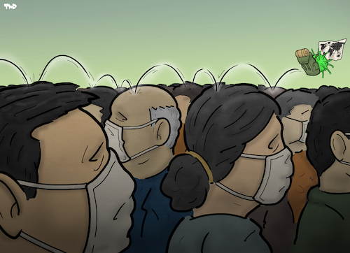

Case Scenarios:
Virus Outbreak :
Call for medical facilities
Ask for first aid
Flood:
Call for food supplies
Ask for Do’s and Don’ts

Slide 5
Key Features :
CONCEPT OF USER AND RESPONDER
PERSONALISED MAP
LIVE TRACKING
PERSONALIZED AI ENABLED CHATBOT
SOCIAL MEDIA BROADCAST OF SOS MESSAGES

Slide 6
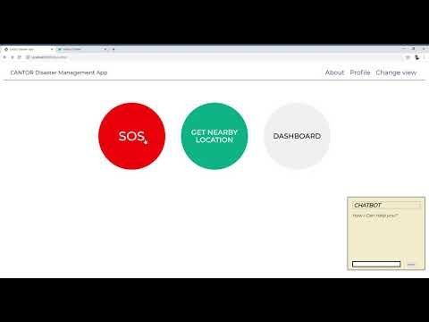
Demo Video :

